Slide 1
III. Software Requirements
Laurea Triennale in Informatica – Corso di Ingegneria del Software I – A.A. 2006/2007 Andrea Polini

Slide 2
Resume from last three lectures
General concepts of software Engineering:
Why software engineering
Software Engineering crisis
Software engineering vs system engineering
Software Engineering VS Computer Science
Software Process (SDLC) and Software Process model
Some software models:
Waterfall
Incremental and Iterative
Agile

Slide 3
Objectives
To introduce the concepts of user and system requirements
To describe functional and non­functional requirements
To explain how software requirements may be organised in a requirements document.
Today we will not specify how to discover or analyse requirements
User requirements | System requirements
Describe what the end-user wants and expects from a system in natural language, focusing on features and functions. | Define the technical specifications of a system, detailing how it will meet those user needs through specific, implementable instructions

Slide 4
Topics Covered
Functional and non­functional requirements
User requirements
System requirements
Interface specification
The software requirements document

Slide 5
Requirements Engineering
The process of establishing the services that the customer requires from a system and the constraints under which it operates and is developed.
The requirements themselves are the descriptions of the system services and constraints that are generated during the requirements engineering process.

Slide 6
What is a requirement?
It may range from a high­level abstract statement of a service or of a system constraint to a detailed mathematical functional specification.
This is inevitable as requirements may serve a dual function
May be the basis for a bid for a contract ­ therefore must be open to interpretation;
May be the basis for the contract itself ­ therefore must be defined in detail;
Both these statements may be called requirements.

Slide 7
Relevance of Requirements
Requirements are probably the activity that deserve the greatest care
Problems inserted in the system during the requirements phase are the most expensive to remove
Studies revealed that around 37% of the problems, developing challenging systems, are related to requirements phases
6.00%
7.00%
12.00%
Other
Poor user input Incomplete requirements Changing requirements Poor technical skills Poor staffing
50.00%
12.00%
13.00%

Slide 8
Requirement Abstraction (Davis)
“If a company wishes to let a contract for a large software development project, it must define its needs in a sufficiently abstract way that a solution is not pre­defined. The requirements must be written so that several contractors can bid for the contract, offering, perhaps, different ways of meeting the client organisation’s needs. Once a contract has been awarded, the contractor must write a system definition for the client in more detail so that the client understands and can validate what the software will do. Both of these documents may be called the requirements document for the system.”

Slide 9
Types of requirement
User requirements
Statements in natural language plus diagrams of the services the system provides and its operational constraints. Written for customers.
System requirements
A structured document setting out detailed descriptions of the system’s functions, services and operational constraints.
Defines what should be implemented so may be part of a contract between client and contractor.

Slide 10
Definition and Specifications
User requirement definition
The system must provide a mean of representing and accessing external files created by other tools
System requirement specification
The user should be provide with facilities to define the type of external files
Each external file type may have associated tool which may be applied to the file Each external file may be represented as a specific icon on the user's display
Facilities should be provided for the icon representing an external file type to be defined by the user
When a user selects an icon representing an external file, the effect of that selection is to apply the tool associated with the type of the external file to the file represented by the selected icon.

Slide 11
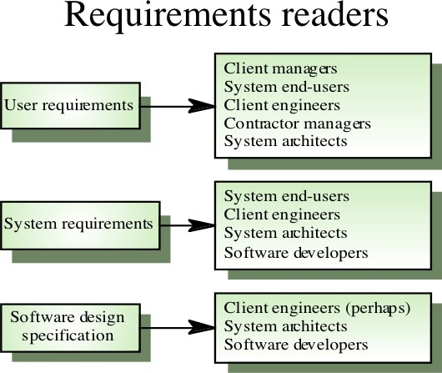

Slide 12
Functional and Non­functional Requirements
Functional requirements
Statements of services the system should provide, how the system should react to particular inputs and how the system should behave in particular situations.
Non­functional requirements
constraints on the services or functions offered by the system such as timing constraints, constraints on the development process, standards, etc.
Domain requirements
Requirements that come from the application domain of the system and that reflect characteristics of that domain.

Slide 13
Functional Requirements
Describe functionality or system services.
Depend on the type of software, expected users and the type of system where the software is used.
Functional user requirements may be high­level statements of what the system should do but functional system requirements should describe the system services in detail.

Slide 14
The LIBSYS System
A library system that provides a single interface to a number of databases of articles in different libraries.
Users can search for, download and print these articles for personal study.

Slide 15
Example of Functional Requirements
The user shall be able to search either all of the initial set of databases or select a subset from it.
The system shall provide appropriate viewers for the user to read documents in the document store.
Every order shall be allocated a unique identifier (ORDER_ID) which the user shall be able to copy to the account’s permanent storage area.

Slide 16
Requirements Imprecision
Can be defined as lack of clarity and specificity in project requirements, leading to ambiguity and different interpretations by stakeholders, developers, and users
Problems arise when requirements are not precisely stated.
Ambiguous requirements may be interpreted in different ways by developers and users.
Consider the term ‘appropriate viewers’
User intention : special purpose viewer for each different document type;
Developer interpretation: ­ Provide a text viewer that shows the contents of the document.
Writing requirements you do not have to prove your language skills. You should not engage finding synonyms

Slide 17
Requirements Completeness and Consistency
In principle, requirements should be both complete and consistent.
Complete
They should include descriptions of all facilities required.
Consistent
There should be no conflicts or contradictions in the descriptions of the system facilities.
In practice, it is impossible to produce a complete and consistent requirements document.

Slide 18
Non­ Functional Requirements
These define system properties and constraints e.g. reliability, response time and storage requirements. Constraints are I/O device capability, system representations, etc.
Process requirements may also be specified mandating a particular CASE system, programming language or development method.
Non­functional requirements may be more critical than functional
requirements. If these are not met, the system is useless.

Slide 19
Non­Functional Classifications
Product requirements
Requirements which specify that the delivered product must behave in a particular way e.g. execution speed, reliability, etc.
Organisational requirements
Requirements which are a consequence of organisational policies and procedures
e.g. process standards used, implementation requirements, etc.
External requirements
Requirements which arise from factors which are external to the system and its development process e.g. interoperability requirements, legislative requirements, etc.

Slide 20
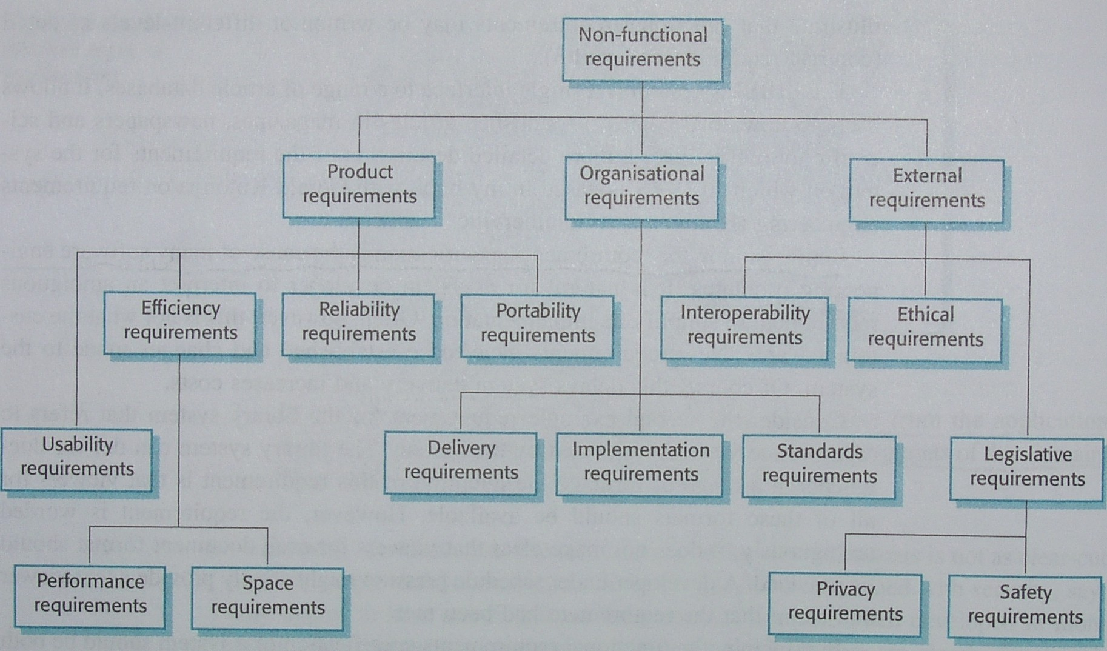
Non­functional Requirements Types

Slide 21
Non­functional Requirements Examples
Product requirement
The user interface for LIBSYS shall be implemented as simple HTML without frames or Java applets.
Organisational requirement
The system development process and deliverable documents shall conform to the process and deliverables defined in XYZCo­SP­STAN­95.
External requirement
The system shall not disclose any personal information about customers apart from their name and reference number to the operators of the system.

Slide 22
Goals and Requirements
Non­functional requirements may be very difficult to state precisely and imprecise requirements may be difficult to verify.
Goal
A general intention of the user such as ease of use.
Verifiable non­functional requirement
A statement using some measure that can be objectively tested.
Goals are helpful to developers as they convey the intentions of the system users.

Slide 23
Examples
A system goal
The system should be easy to use by experienced controllers and should be organised in such a way that user errors are minimised.
A verifiable non­functional requirement
Experienced controllers shall be able to use all the system functions after a total of two hours training. After this training, the average number of errors made by experienced users shall not exceed two per day.

Slide 24
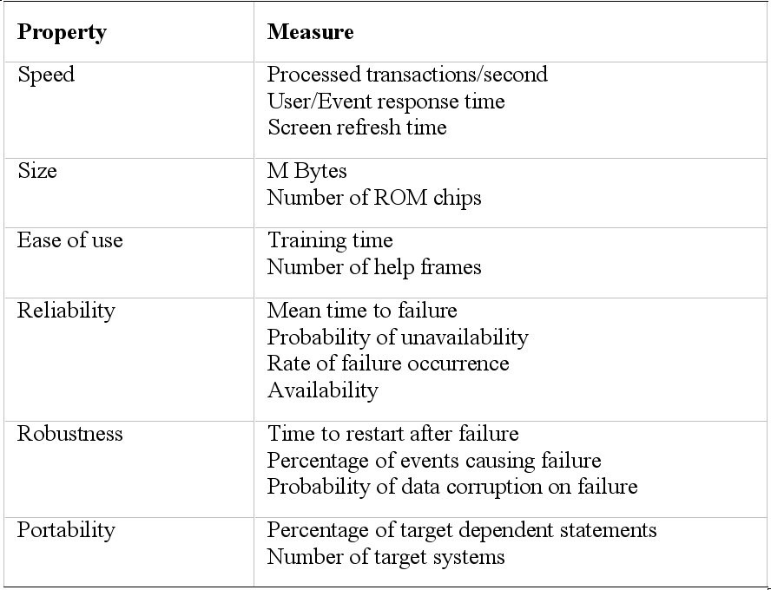
Requirements Measures

Slide 25
Requirements Interaction
Conflicts between different non­functional requirements are common in complex systems.
Spacecraft system
To minimise weight, the number of separate chips in the system should be minimised.
To minimise power consumption, lower power chips should be used.
However, using low power chips may mean that more chips have to be used. Which is the most critical requirement?

Slide 26
Domain Requirements
Derived from the application domain and describe system characteristics and features that reflect the domain.
Domain requirements be new functional requirements, constraints on existing requirements or define specific computations.
If domain requirements are not satisfied, the system may be unworkable.

Slide 27
Library System Domain Requirements
There shall be a standard user interface to all databases which shall be based on the Z39.50 standard.
Because of copyright restrictions, some documents must be deleted immediately on arrival. Depending on the user’s requirements, these documents will either be printed locally on the system server for manually forwarding to the user or routed to a network printer.

Slide 28
Train Protection System
The deceleration of the train shall be computed as:
D = D + D
train control gradient
where D is 9.81ms₂ * compensated gradient/alpha and where the
gradient
values of 9.81ms₂ /alpha are known for different types of train.

Slide 29
Domain Requirements Problems
Understandability
Requirements are expressed in the language of the application domain;
This is often not understood by software engineers developing the system.
Implicitness
Domain specialists understand the area so well that they do not think of making the domain requirements explicit.

Slide 30
User Requirements
Should describe functional and non­functional requirements in such a way that they are understandable by system users who don’t have detailed technical knowledge.
User requirements are defined using natural language, tables and diagrams as these can be understood by all users.

Slide 31
Problems with Natural Language
Lack of clarity
Precision is difficult without making the document difficult to read.
Requirements confusion
Functional and non­functional requirements tend to be mixed­up.
Requirements amalgamation
Several different requirements may be expressed together.

Slide 32
LIBSYS Requirement
4..5 LIBSYS shall provide a financial accounting system that maintains records of all payments made by users of the system. System managers may configure this system so that regular users may receive discounted rates.

Slide 33
Editor Grid Requirement
2.6 Grid facilities To assist in the positioning of entities on a diagram, the user may turn on a grid in either centimetres or inches, via an option on the control panel. Initially, the grid is off. The grid may be turned on and off at any time during an editing session and can be toggled between inches and centimetres at any time. A grid option will be provided on the reduce­to­fit view but the number of grid lines shown will be reduced to avoid filling the smaller diagram with grid lines.

Slide 34
Requirement Problems
Database requirements includes both conceptual and detailed information
Describes the concept of a financial accounting system that is to be included in LIBSYS;
However, it also includes the detail that managers can configure this system ­ this is unnecessary at this level.
Grid requirement mixes three different kinds of requirement
Conceptual functional requirement (the need for a grid); Non­functional requirement (grid units);
Non­functional UI requirement (grid switching).

Slide 35
Structured Presentation
2.6.1. Grid facilities
The editor shall provide a grid facility where a matrix of horizontal and vertical lines provide a background to the editor window. This grid shall be a passive grid where the alignment of entities is the user's responsibility.
Rationale: A grid helps the user to create a tidy diagram with well­spaced entities. Although an active grid, where entities 'snap­to' grid lines can be useful, the positioning is imprecise. The user is the best person to decide where entities should be positioned.
Specification: ECLIPSE/WS/Tools/DE/FS Section 5.6
Source: Ray Wilson, Glasgow Office

Slide 36
Guidelines for Writing Requirements
Invent a standard format and use it for all requirements.
Use language in a consistent way. Use shall for mandatory requirements, should for desirable requirements.
Use text highlighting to identify key parts of the requirement. Avoid the use of computer jargon.

Slide 37
System Requirements
More detailed specifications of system functions, services and constraints than user requirements.
They are intended to be a basis for designing the system. They may be incorporated into the system contract.
System requirements may be defined or illustrated using system
models discussed in Chapter 8.

Slide 38
Requirements and Design
In principle, requirements should state what the system should do
and the design should describe how it does this.
In practice, requirements and design are inseparable
A system architecture may be designed to structure the requirements;
The system may inter­operate with other systems that generate design requirements;
The use of a specific design may be a domain requirement.

Slide 39


Problems with NL Specifications
Ambiguity
The readers and writers of the requirement must interpret the same words in the same way. NL is naturally ambiguous so this is very difficult.
Over­flexibility
The same thing may be said in a number of different ways in the specification.
Lack of modularisation
NL structures are inadequate to structure system requirements.

Slide 40
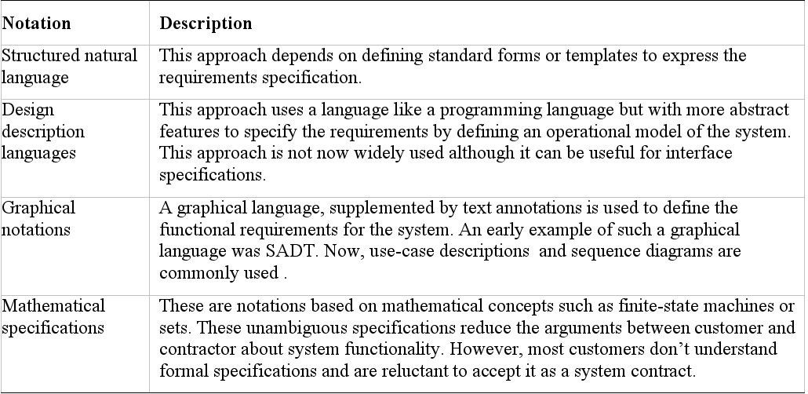
Alternatives to NL Specification

Slide 41
Structured Language Specifications
The freedom of the requirements writer is limited by a predefined
template for requirements.
All requirements are written in a standard way.
The terminology used in the description may be limited.
The advantage is that the most of the expressiveness of natural
language is maintained but a degree of uniformity is imposed on the specification.

Slide 42
Form­based Specifications
Definition of the function or entity.
Description of inputs and where they come from. Description of outputs and where they go to.
Indication of other entities required.
Pre and post conditions (if appropriate). The side effects (if any) of the function.

Slide 43
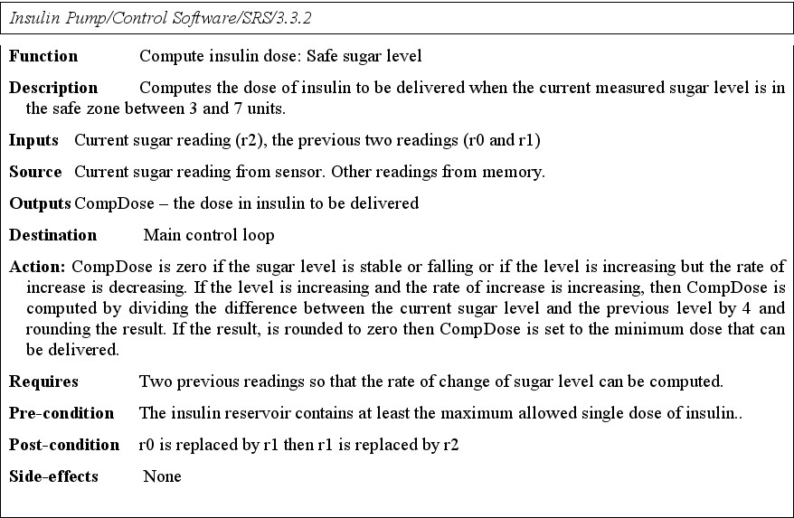
Form­based Node Specification

Slide 44
Tabular Specification
Used to supplement natural language.
Particularly useful when you have to define a number of possible alternative courses of action

Slide 45
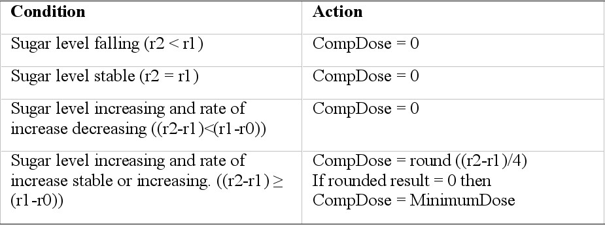
Tabular Specification

Slide 46
Graphical Models
Graphical models are most useful when you need to show how state changes or where you need to describe a sequence of actions.
Different graphical models are explained in Chapter 8.

Slide 47
Sequence Diagrams
These show the sequence of events that take place during some user interaction with a system.
You read them from top to bottom to see the order of the actions that take place.
Cash withdrawal from an ATM
Validate card; Handle request;
Complete transaction.

Slide 48
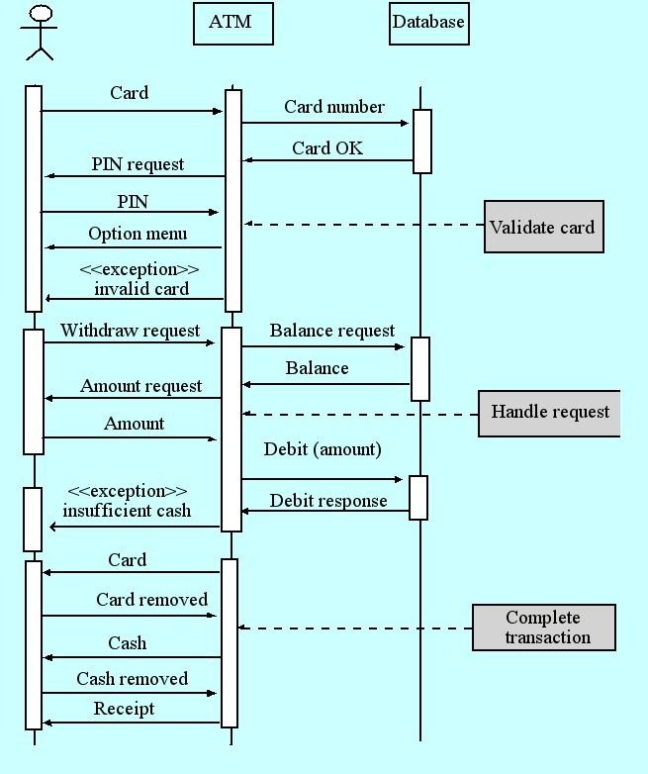
Sequence Diagram of ATM withdrawal

Slide 49
Interface Specification
Most systems must operate with other systems and the operating interfaces must be specified as part of the requirements.
Three types of interface may have to be defined
Procedural interfaces (API);
Data structures that are exchanged; Data representations.
Formal notations are an effective technique for
interface specification.

Slide 50
PDL Interface Description
interface PrintServer {
// defines an abstract printer server
// requires: interface Printer, interface PrintDoc
// provides: initialize, print, displayPrintQueue,
// cancelPrintJob, switchPrinter
void initialize (Printer p);
void print (Printer p, PrintDoc d);
void displayPrintQueue (Printer p);
void cancelPrintJob (Printer p, PrintDoc d);
void switchPrinter (Printer p1, Printer p2, PrintDoc d);
} //PrintServer

Slide 51
The Requirements Document
The requirements document is the official statement of what is required of the system developers.
Should include both a definition of user
requirements and a specification of the system requirements.
It is NOT a design document. As far as possible, it should set of WHAT the system should do rather than HOW it should do it

Slide 52
Users of a Requirements Document
System Customers
Specify the requirements and read them to check that they meet their needs. They specify changes to the requirements
Managers
Use the requirements document to plan a bid for the system and to plan the system development process
System Engineers
Use the requirements to understand what system is to be developed
System Test Engineers
Use the requirements to develop validation tests for the system
System Maintenance Engineers
Use the requirements to help understand the system and the relationship between its parts

Slide 53
IEEE Requirements Standard
Defines a generic structure for a requirements document that must be instantiated for each specific system.
Introduction. General description.
Specific requirements. Appendices.
Index.

Slide 54
Requirements Document Structure
Preface Introduction Glossary
User requirements definition System architecture
System requirements specification System models
System evolution
Appendices Index

Slide 55
Key Points
Requirements set out what the system should do and define constraints on its operation and implementation.
Functional requirements set out services the system should provide. Non­functional requirements constrain the system being developed or the development process.
User requirements are high­level statements of what the system
should do. User requirements should be written using natural language, tables and diagrams.

Slide 56
Key Points
System requirements are intended to communicate the functions that the system should provide.
A software requirements document is an agreed statement of the system requirements.
The IEEE standard is a useful starting point for defining more detailed specific requirements standards.

Slide 57
Distributori Automatici di Cibo e Bevande
Un distributore automatico di cibi e bevande permette la selezione e l'acquisto di cibo o bevande dietro il pagamento della rispondente somma di denaro. Per poter acquistare un prodotto il cliente dovrà depositare la somma necessaria e selezionare il prodotto prescelto. La conferma dell'aquisto avverrà pigiando il corrispondente pulsante oppure, per i clienti muniti di chiavetta, tramite l'inserimento di un codice personale. Se non sono stati inseriti soldi la pressione del pulsante permetterà di visualizzare il costo di un prodotto.
Come giudicate questo requisito? Vi sembra abbastanza chiaro?

Slide 58
DABC
Chiaramente il requisito è ambiguo e presenta molte omissioni:
Cosa accade se il cliente seleziona un prodotto più costoso rispetto alla somma inserita?
Selezione del prodotto ed inserimento dei soldi devono rispettare un ordine? Se seleziono un prodotto per visualizzare il prezzo dunque inserisco dei soldi e pigio il pulsante corrispondente di conferma il prodotto sarà erogato oppure no?
La selezione del prodotto e la conferma dovrà avvenire tramite lo stesso pulsante? Cosa accade se inserisco soldi mentre una chiave è inserita?
Cosa accade se il codice personale è errato?
Come posso depositare soldi aumentando il credito su di una chiavetta? E' possibile avere più prodotti alla volta?
IL RESTO!!!

Slide 59
DABC in un Formato Strutturato
Function: Acquisto di un prodotto in contanti
Description: processo che permette ad un cliente di acquistare un bene dietro pagamento del corrispettivo in denaro
Inputs: Monete, Selezione del prodotto, Conferma
Output: Prodotto, resto
Azioni: Il sistema riceve dal cliente un certo ammontare di denaro attraverso la fessura per il contante. Il sistema evidenzia i pulsanti di conferma per tutti i prodotti che hanno un prezzo inferiore alla somma inserita. Il sistema riceve la selezione di un prodotto tra quelli illuminati e attiva il lampeggio del relativo pulsante. Il sistema riceve la conferma dell'acquisto tramite la pressione del pulsante lameggiante e corrispondentemente fornisce il prodotto ed il resto
Pre­condizioni: il sistema è disponibile a ricevere un ordine, non vi sono altre transazioni in corso
Post­condizioni: La somma restituita è pari alla differenza tra quanto versato ed il prezzo del prodotto acquistato, il prodotto fornito corrisponde a quello selezionato dal cliente, la macchina è pronta per una nuova transazione

Slide 60
DABC Esempi di Requisiti non Funzionali
Può verificarsi al più un errore ogni 1000 transazioni
il sistema non deve mai fornire cibo e bevande se la somma corrispondente non è stata già versata
Il sistema può essere indisponibile al più per un'ora la settimana
Se il sistema va in errore deve essere possibile riportarlo in uno stato corretto in non più di 2 minuti
Il tempo per illuminare un pulsante deve essere inferiore a 0.5 sec. Dopo aver concluso una transazione il sistema deve rendersi disponibile entro 3 sec.

Slide 61
Homework
Write a requirements document whose possible implementation corresponds to the vending machine with the door on the ground floor.

Slide 62
Thank you for your attention

